Slide 1
Making this resource work for you
Prior to teaching this lesson, please refer to the ‘Unit Overview and Planning Document’.
Further guidance on planning Science Mastery lessons can be found in the detailed planning guidance document.
Refer to the ‘notes’ section on each slide for useful information, including suggested expositions, pedagogical content knowledge, suggested questions, answers and more. Consider using presenter mode so you can see this guidance throughout the lesson.
The introduction slides can be adapted to suit your teaching style and the needs of your class.
Before the lesson, adapt the fix-it slide to address any misconceptions identified in the previous lesson’s exit ticket.
Choose from the suggested activities to suit your class. The intention is not that you complete all of these, but that you select those which ones are most appropriate for your students. It may be appropriate to further adapt activities for your students.
These lessons are designed to occupy approximately 1 hour. To adapt for a shorter or longer lesson duration we advise you to adapt the activity section accordingly.
Please consider using the final slide to send feedback about this lesson or examples of PowerPoints that you have adapted to our design team. Your feedback is used to improve Science Mastery for all of our teachers and students. We appreciate all suggestions and comments.
Thank you for reading!
The Science Mastery Team

Slide 2
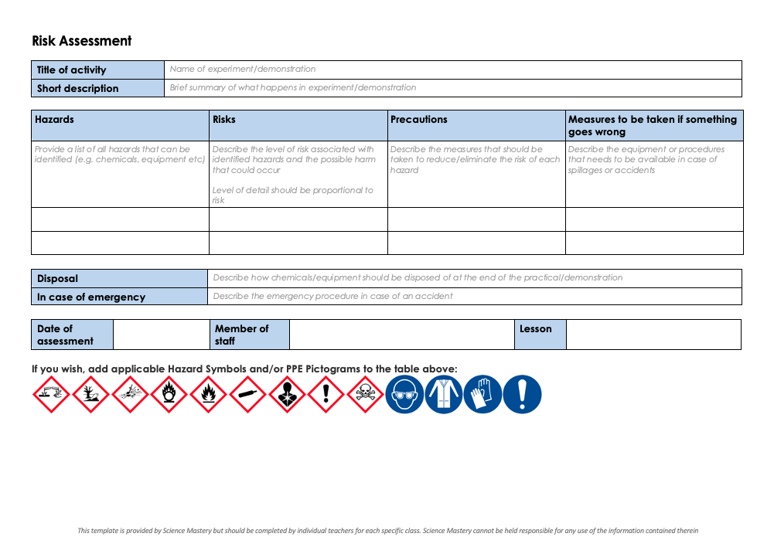
Practical Activity
This lesson contains a practical activity (either a whole class activity or a demonstration)
A risk assessment must be completed for this practical
The template risk assessment can be found here.
The risk assessment should be specific to the class involved and written only by the teaching member of staff
The risk assessment should refer to the current CLEAPSS Hazcards for all chemicals used in the practical for safety and disposal notes.
A list of chemicals used can be found in the Practical Guide
It is good practice for students to wear safety spectacles during all class practicals and demonstrations
Thank you for reading!
The Science Mastery Team

Slide 3
Taking it Further: RPA Determining an Unknown Concentration by Titration
Answer the questions below.
State the formula for sulfuric acid.
Calculate the relative formula mass of sodium hydroxide (NaOH).
Write a word equation for the reaction between sulfuric acid and sodium hydroxide.
What type of reaction is this?
Name the salt that would be produced in a reaction between hydrochloric acid and potassium hydroxide.
H₂SO₄
23+16+1 = 40
Sodium hydroxide + sulfuric acid → sodium sulfate + water
Neutralisation
Potassium chloride
Notes:
Big idea: Reactions rearrange matter
Foundation: State the general equation for the reaction between an acid and an alkali.
Stretch: Write a balanced symbol equation for the reaction between sodium hydroxide and sulfuric acid.
Answers:
Foundation: Acid + alkali → salt + water
Stretch: 2NaOH + H₂SO₄ → Na₂SO₄ + 2H₂O

Slide 4
Taking it Further: RPA Determining an Unknown Concentration by Titration
Do Now:
State the formula for sulfuric acid.
Calculate the relative formula mass of sodium hydroxide (NaOH).
Write a word equation for the reaction between sulfuric acid and sodium hydroxide.
What type of reaction is this?
Name the salt that would be produced in a reaction between hydrochloric acid and potassium hydroxide.
Drill:
Describe three ways to tell if a substance is acidic.
State the colour that Universal Indicator would turn in an acid.
Give a disadvantage of Universal Indicator.
Notes:
Drill answers:
Using litmus paper, a pH probe or Universal indicator
Red/orange
It can give a rough pH value but the colour can be subjective.

Slide 5
Taking it Further: RPA Determining an Unknown Concentration by Titration
Read Now:
Titrations are a method of quantitative analysis. This means that they provide numerical information, unlike in a qualitative analysis. For example, in a titration, you can determine a volume of acid required to neutralise an alkali. This is a numerical quantity. However, in a qualitative analysis, a numerical value is not given. An example of a qualitative analysis that we have seen already is using different food tests to identify the presence of different nutrients. Iodine can be used to test for the presence of starch. If starch is present, iodine turns blue-black. These reagents can show whether or not a nutrient is present, but cannot tell you how much of a nutrient is present. The starch test is also useful when identifying if a leaf has produced starch, showing that it has been converted from glucose produced in photosynthesis.
Explain what is meant by a quantitative analysis.
Explain the difference between a quantitative analysis and a qualitative analysis.
Give an example of a quantitative analysis.
Describe the result of a positive test for starch.

Slide 6
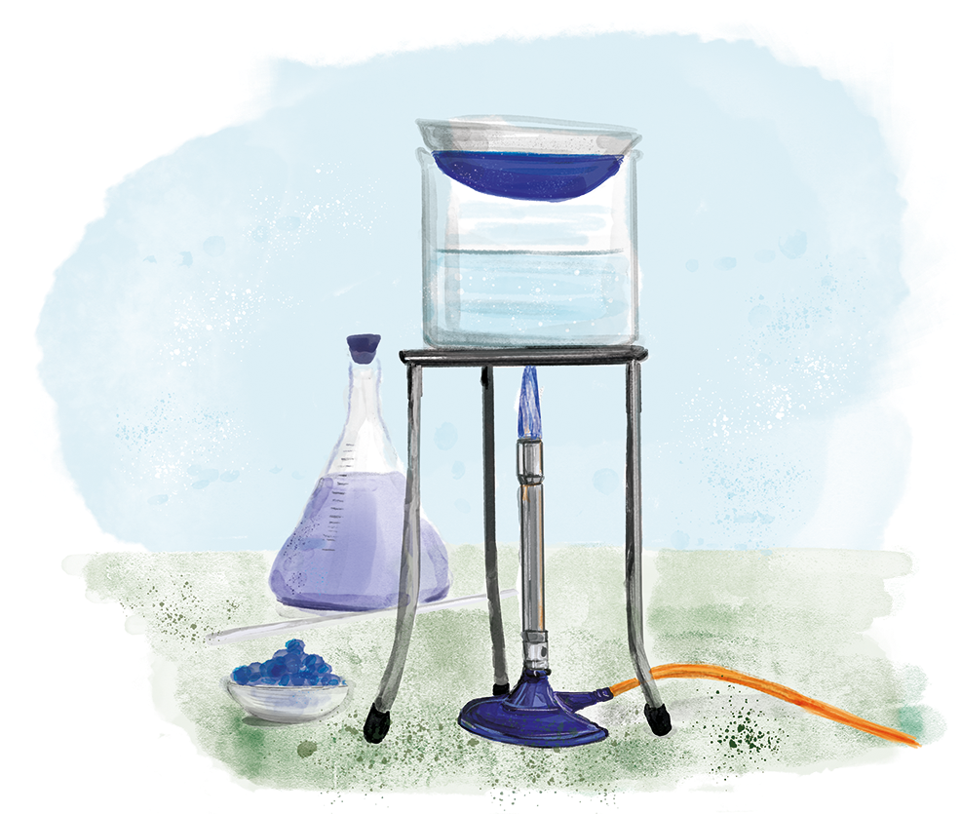
C4.3.11 C4.3.12
03/02/2025
Taking it Further: RPA Acid-Alkali Titration
C4.3.1 Prior Knowledge Review
C4.3.2 (HT) Introducing the Mole
C4.3.3 (HT) Mole Calculations
C4.3.4 PKR: Concentration
C4.3.5 TIF: Calculating Concentration
C4.3.6 TIF: Calculating an Unknown Concentration
C4.3.7 (HT) Amounts of Substances in Equations
C4.3.8 (HT) Limiting Reactants
C4.3.9 PKR: Reactions of Acids
C4.3.10 Acids, Alkalis and Neutralisation
C4.3.11 TIF: Acid-Alkali Titration
C4.3.12 TIF: Acid-Alkali Titration Analysis
C4.3.13 TIF: Titration Calculations
C4.3.14 (HT) Strong and Weak Acids
C4.3.15 TIF: Volumes of Gases
Notes:
Big idea: Reactions rearrange matter
In this lesson, students will be introduced to the titration required practical and carry it out, as well as doing some initial analysis. In the following lesson, they will use their value of titre volume to determine the unknown concentration.
Suggested Hook:
What happens when an acid reacts with an alkali? What are the products? What would the pH be if the exact same amount of acid reacted with the exact same amount of alkali?

Slide 7

Following this lesson, students will be able to:
Describe a method to carry out a titration
Identify concordant results
Explain the most appropriate apparatus to use for a given function
Key Words:
acid
alkali
titration
neutralisation
titre
concordant
phenolphthalein
Notes:
Guidance:
See unit overview document and planning guidance to see how these objectives are typically assessed at GCSE, including examples of what students should be able to do following this lesson.
Planning for different needs:
The learning objectives given on this slide are suggested based on the most common requirements for exams, however they can be adapted based on the needs of different classes.
For best practice, the unit preparation booklet should be used to determine the appropriate focus of lessons within the unit.
While it is not possible to explicitly split content into levelled grades, we recommend that lesson objectives can be classified as critical, core or stretch.
Critical: the content or skill is essential for all students to be able to progress.
Core: the content or skill is important for students to progress, but other opportunities may be available to revisit it.
Stretch: the content or skill may not be essential for all students but is important for students aiming for the highest grades.
Key skill: this is a crucial skill being developed in this unit as part of the skill mapping
C4.3.11 C4.3.12 Lesson Objectives:
Key skill: Describe a method to carry out a titration
Key skill: Identify concordant results
Key skill: Explain the most appropriate apparatus to use for a given function

Slide 8
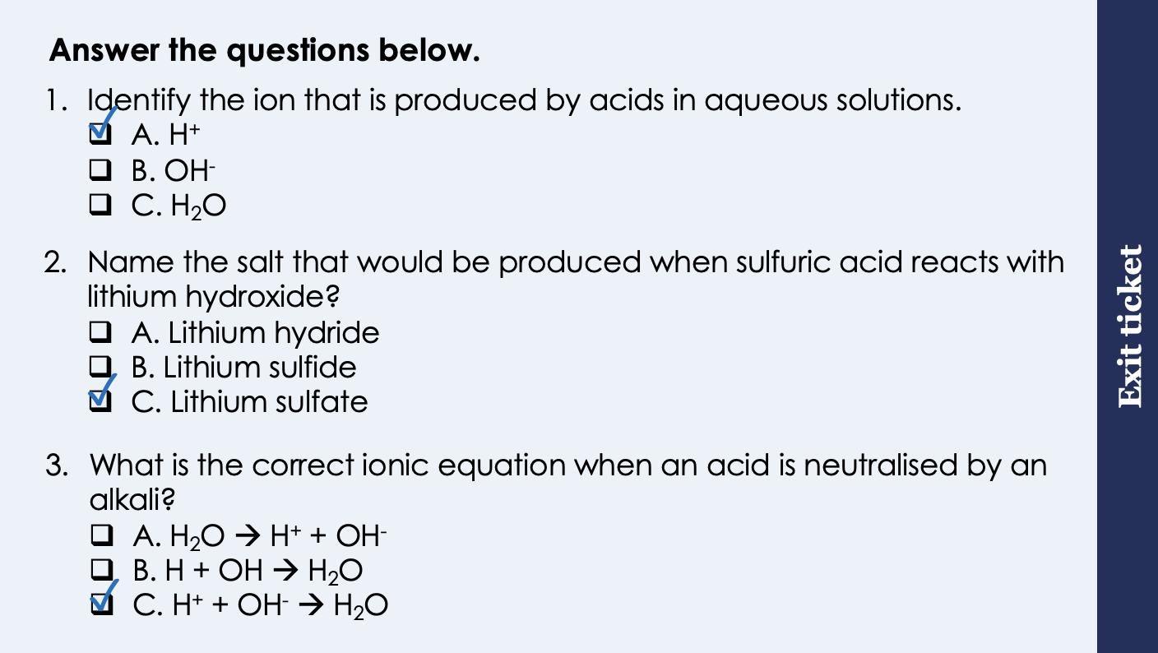
This is the fix-it portion of the lesson
The fix-it is an opportunity to respond to gaps in knowledge, especially those identified by the pre-unit quiz.
The teacher should customise this slide as needed, to facilitate
reteach, explanation, demonstration or modelling of ideas and concepts that students have not yet grasped or have misunderstood.
practise answering specific questions or of key skills.
redrafting or improving previous work.
Notes:
Purpose: to spend time on any gaps identified in previous learning from exit ticket.
Fix-it guidance from previous exit ticket:
Q1. Answer: A
If students answer B, they are not clear on the ions in solution produced by acids and alkalis. If students answer C, they have recognised water from the neutralisation reaction, but not the correct ion. To fix-it, review the ions produced by acids and alkalis in solution and the ionic equation in a neutralisation reaction.
Q2. Answer: C
If students answer A, it shows they have been confused by the hydroxide part of the name, which is a common mistake. If students answer B, they have recognised the sulfur element but not the correct name. To fix-it, review the formula for sulfuric acid and why it produces sulfates rather than sulfides.
Q3. Answer: C
If students answer A, they have got the equation the wrong way round. If students answer B, it shows that students have recognised the elements but not the key aspect that they are ions. To fix-it, review the definition of a neutralisation reaction and show students the ions involved.

Slide 9
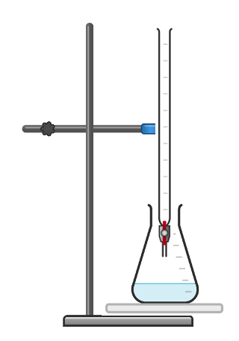
Titration
A titration is a quantitative analysis.
It can be used to determine the volume of an acid (or alkali) needed to neutralise a volume of an alkali (or acid).
Notes:
Suggested exposition:
Titration is a process or method that we can use to determine the volume of an acid or alkali required to neutralise an acid or alkali. It is a form of quantitative analysis because it provides numerical information. In this unit we are looking at quantitative chemistry, which is all about numerical values, such as relative formula mass and number of moles.
Quantitative analysis is different from qualitative analysis. An example of a qualitative analysis is food tests. We can use different reagents to test for the presence of different nutrients. They provide information about whether the nutrient is present or not, but not how much of the nutrient is present. This means that they are qualitative, not quantitative.
So titration is a quantitative analysis. How does it work?
A titration works by determining the volume of a solution required to completely neutralise a known volume (and known concentration) of an acid or alkali. We can use titration to determine a required volume of either acid or alkali, we then just have to neutralise the other.

Slide 10
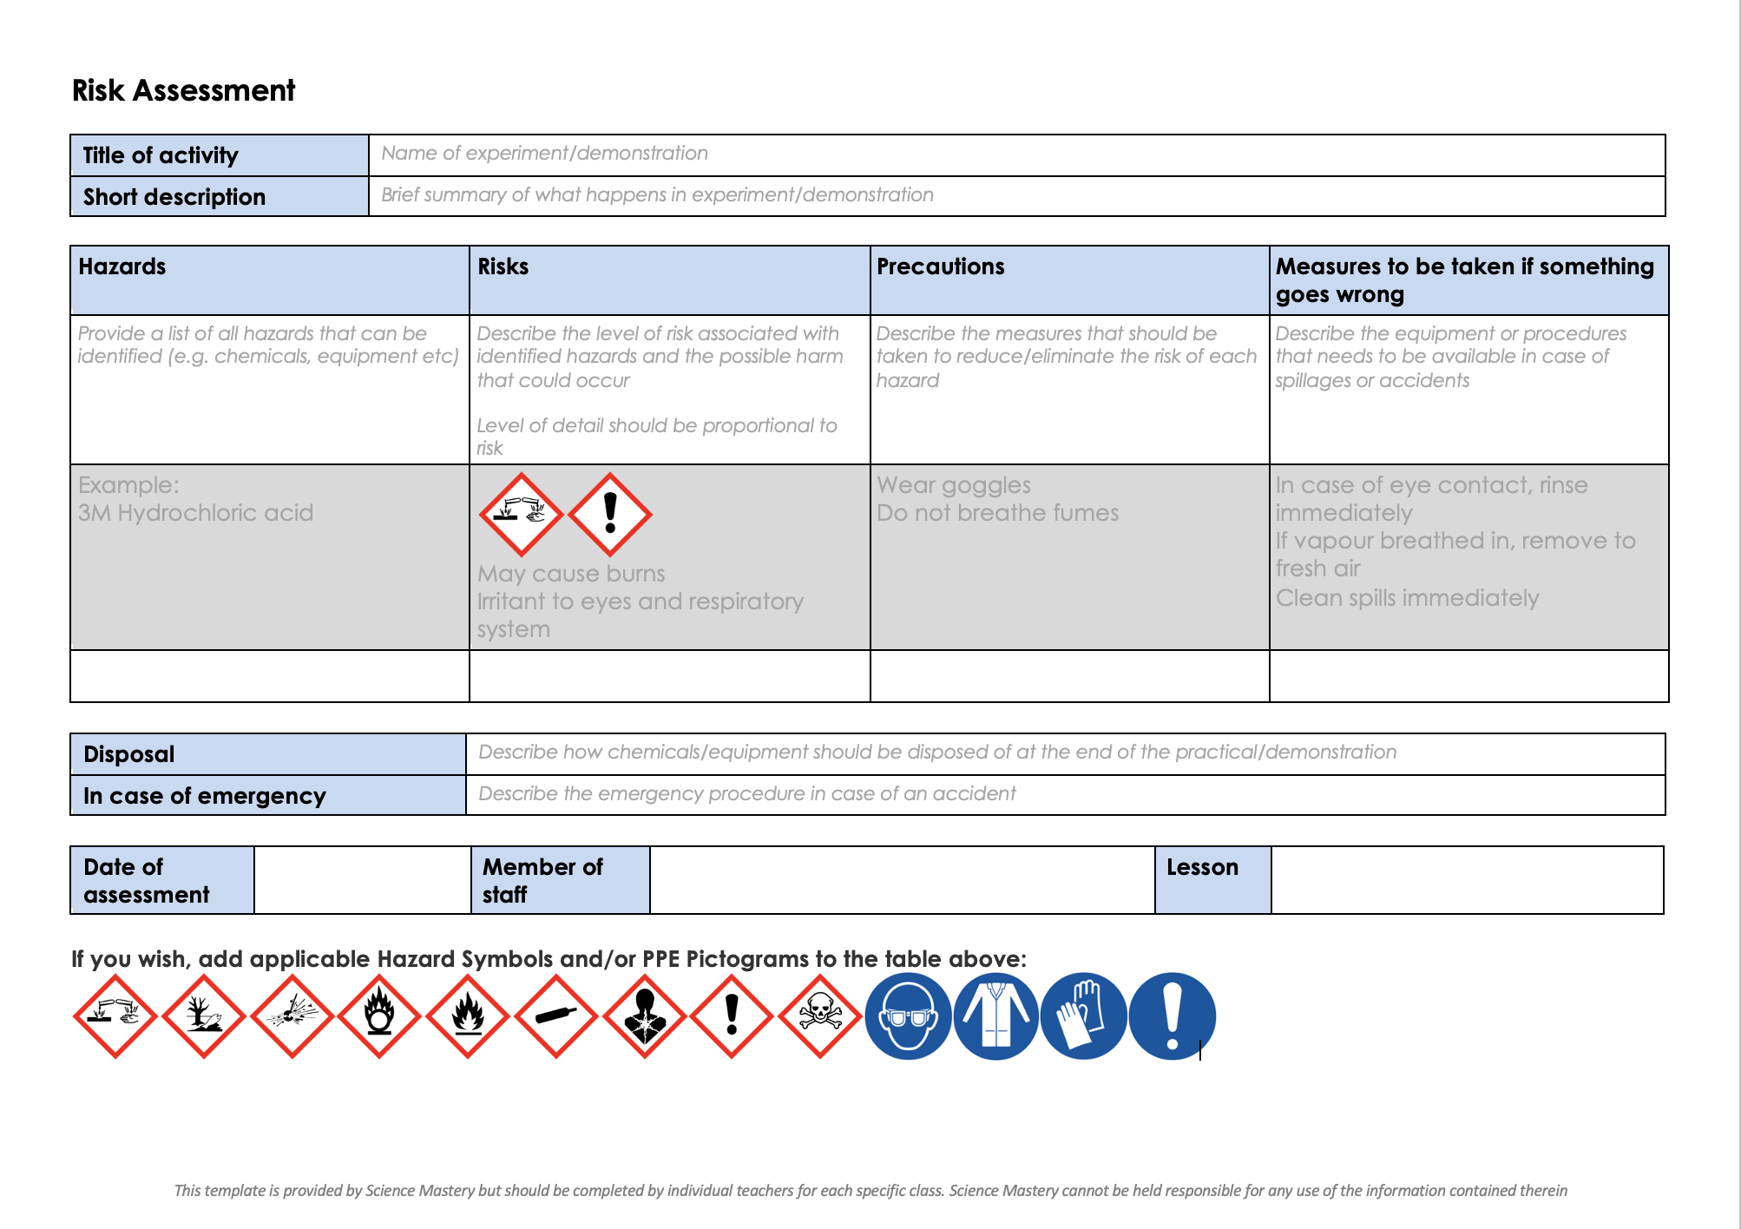
Risk Assessment
A risk assessment must be completed for this practical
The template risk assessment can be found here.

Slide 11
Titration Demonstration
Measure 25 cm³ of alkali using a pipette
Add the alkali to a conical flask
Set up a burette with acid. Rinse the burette with the acid solution and flush the tap to remove air bubbles
Add a few drops of indicator (phenolphthalein) to the conical flask
Place the conical flask on a white tile
Record the starting volume of acid in the burette
Open the tap to gradually add acid from the burette to the conical flask, while swirling the conical flask
When the indicator changes colour, this is the end-point of the titration
Use the starting and final volumes on the burette to determine the volume of acid used
Notes:
This is best done as a demonstration, so that students can see the steps being modelled.
Suggested exposition:
So lets say we want to know the volume of an acid required to neutralise an alkali.
Firstly, a pipette is used to accurately measure a certain volume of alkali. A pipette filler is used to fill the pipette safely if a glass pipette is being used. Pipettes have the highest resolution of the instruments used to measure volume, so we can use them to measure a precise and accurate known volume, say 25 cm³.
Measure 25 cm³ of alkali using pipette.
Then we add our volume of alkali into a conical flask.
Add alkali to conical flask.
A burette is used to add small, measured volumes of one reactant to the other reactant in the conical flask. Before starting the titration, the burette should be rinsed with the solution it is going to contain and clamped vertically. Once filled the tap should be flushed to remove any air bubbles. A burette is used because it allows a variable volume to be measured - remember this is the volume that we are trying to determine, so when we get close to the end-point of our titration, we can use the burette to add acid drop by drop.
Set up burette with acid, rinsing out with acid solution and flushing tap to remove air bubbles. Note the starting volume of acid in the burette.
A few drops of indicator should be added to conical flask. The indicator we will use is phenolphthalein, but other suitable indicators are methyl orange or thymol blue. These indicators are used because they give a clear colour change when the titration is complete. We will think more about why Universal Indicator is not used later. We only use a few drops of indicator because many indicators are actually weak acids or alkalis, so if we add too much it would affect the results of our titration.
Add a few drops of phenolphthalein to the conical flask.
We place the conical flask on top of a white tile. This allows the colour change to be seen clearly.
Place conical flask on white tile.
Record the starting volume of acid in the burette.
We gradually add acid from the burette into the conical flask, where it reacts with the alkali. The indicator shows by a colour change when all of the alkali in the conical flask has been neutralised. This is called the end point.
Gradually add acid until the indicator shows a colour change and the end-point is reached.
8. Phenolphthalein is pink in alkaline solutions and colourless in acidic solutions. This means that it is pink in the conical flask when we add it to the alkali, then as soon as all the alkali has been neutralised, the solution is no longer alkaline and the phenolphthalein changes colour to clear.
As we are adding acid to alkali, we should swirl the conical flask so that the acid disperses through the liquid.
9. Then we measure the difference between the burette reading at the start and the reading at the end of the titration. This gives the volume of acid added. This volume is called a titre. The first titre is usually ignored, as it is a rough result. Multiple titrations are usually carried out, and an average (mean) titre is calculated for any that are within 0.2 cm³ of each other.Results that are within 0.2cm³ of each other are called concordant results.
Measure the volume of acid used from the difference in the burette readings at the start and end.
You may wish to read through the method again with students, asking them to write down any measurements they will be taking, or what each piece of equipment will be used for.

Slide 12
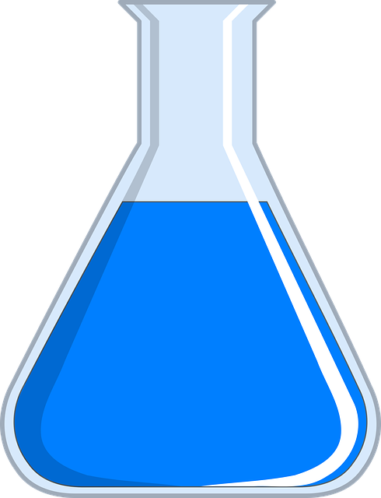
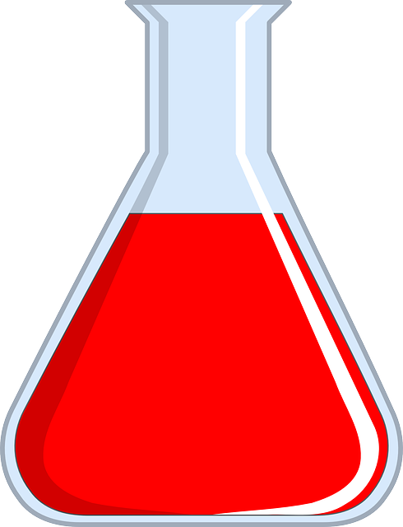
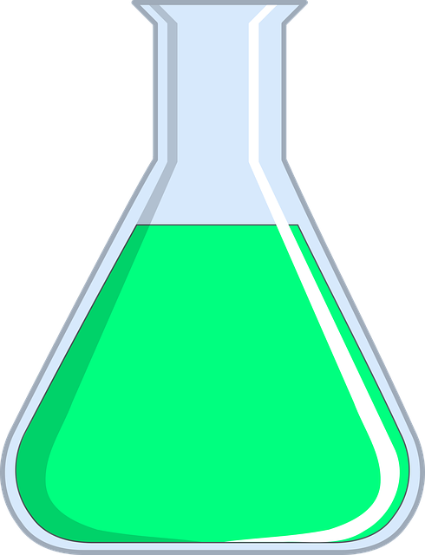
Using Titration
Sodium hydroxide + sulfuric acid → sodium sulfate + water
2NaOH + H₂SO₄ → Na₂SO₄ + 2H₂O
Volume = 25 cm³
Volume = ?
Notes:
Suggested exposition:
Let’s quickly revisit the reaction between an acid and an alkali. In this case we are using sodium hydroxide to neutralise sulfuric acid. We are using a known volume of sodium hydroxide (25 cm3) to determine the volume of sulfuric acid is needed to neutralise it.
We could do the titration the other way, adding a known volume of acid to determine the volume of alkali required to neutralise it.
In the next lesson, we will come back to these values and use them to determine the concentration of the acid (HT only), but for now we are only concerned about the volume.
So we want to determine the volume of acid that completely neutralises 25 cm3 of sodium hydroxide.
How will we know if all the sodium hydroxide has been neutralised?
Sodium hydroxide is an alkali, so when it has been completely neutralised by sulfuric acid, sodium sulfate and water will be made. This means the pH will no longer be alkaline, which we can tell from an indicator.

Slide 13
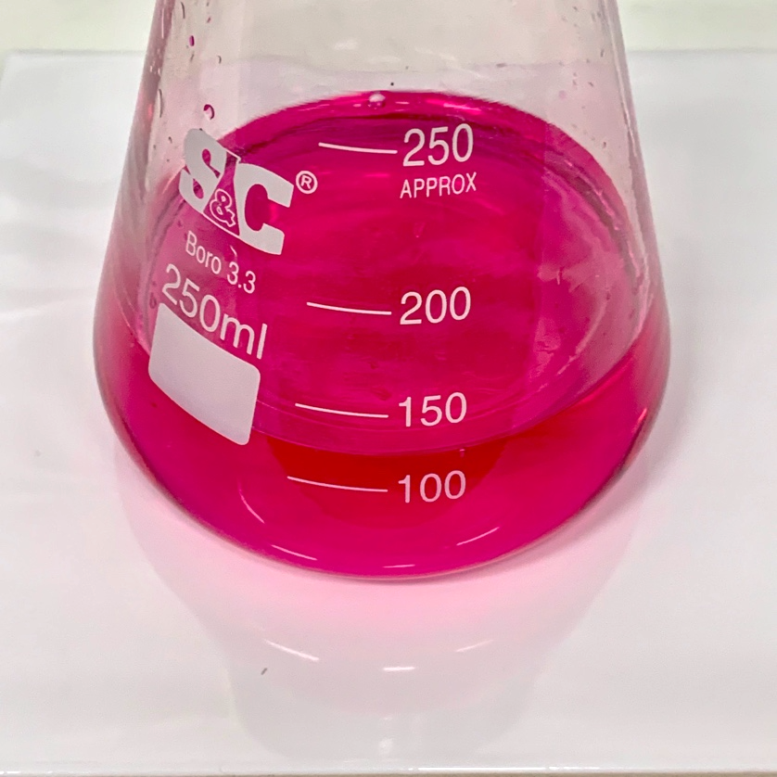
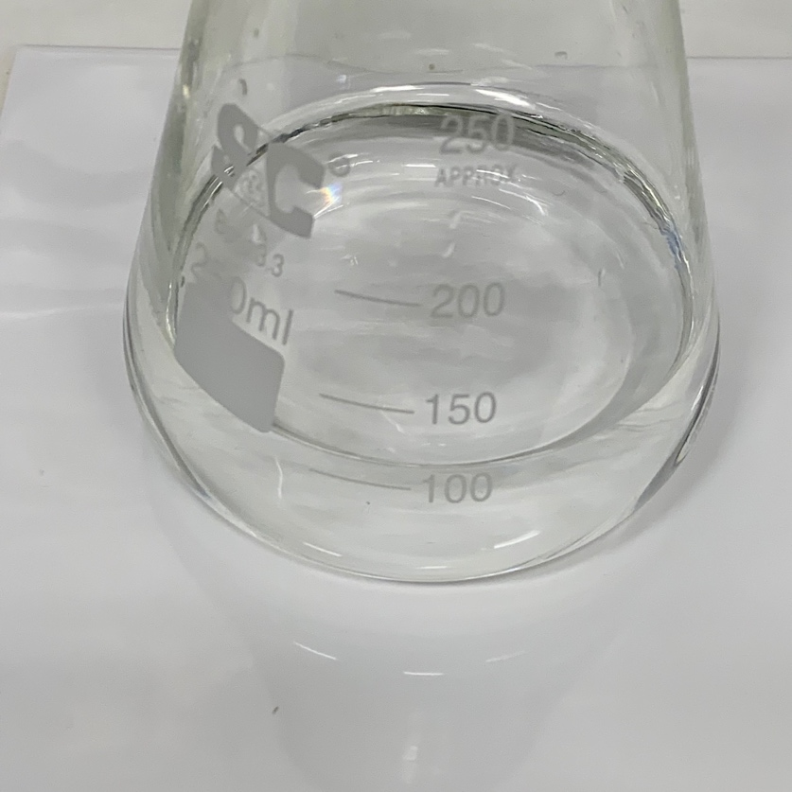
End-point of titration
Alkali
Neutral/Acid
Notes:
Suggested exposition:
The indicator tells us the end-point of the reaction. This is when all of the alkali has been completely neutralised by the acid.
In this case, we are using phenolphthalein. Phenolphthalein is pink in alkaline solutions and colourless in neutral or acidic solutions.
This means that when all the alkali has been neutralised, the phenolphthalein changes from pink to colourless. This is the colour change we are looking out for.
Why don’t we use Universal Indicator?
What would the colour of UI be in an alkaline solution?
Purple/blue
What would happen to UI if the solution was neutralised?
UI would turn green
Universal indicator is useful for estimating a pH of a solution, but it cannot give an exact pH or show the exact end-point because the colour change to green can be subjective and take place slowly. One person may say that the UI is now green, but another person may say it is still blue-green.
Phenolphthalein is used because it shows a very obvious colour change, meaning that we can get an exact volume of acid that neutralises the alkali, making our results as accurate as possible.

Slide 14
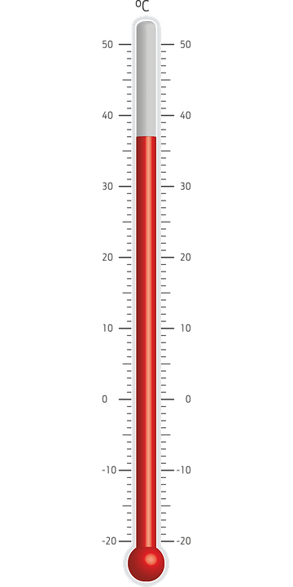
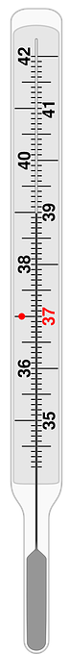
Resolution of instruments
We can estimate uncertainty of measurements from the resolution of the instrument.
The uncertainty can be estimated as half the smallest interval.
For a thermometer with resolution of 1 ºC, the uncertainty is 0.5 ºC.
For a pipette with resolution of 0.1 cm³, the uncertainty is 0.05 cm³.
Notes:
Suggested exposition:
Whenever we take measurements in chemistry, there is always some uncertainty about the measurements. This means how likely it is that the true value lies within the uncertainty range. We can estimate the uncertainty of measurements is by using the resolution of the instrument. The instrument refers to whichever piece of apparatus is being used to do the measuring. The resolution of an instrument is the smallest interval that can be measured using that instrument. For example, a thermometer which has every 1.0 ºC (left) marked on has a resolution of 1.0 ºC, and a thermometer which has intervals marked on every 0.1 ºC (right) has a resolution of 0.1 ºC. The smaller the intervals, the greater the resolution of an instrument. A high resolution allows us to take the most precise measurements possible.
The uncertainty of a measuring instrument is estimated as plus or minus (±) half the smallest interval. For our thermometer with resolution of 1.0°C, the uncertainty is ± 0.5°C. What this actually means is that a student made a measurement of 37.0 ºC using this thermometer, the actual temperature could be as low as 36.5 ºC or as high as 37.5ºC. If it was lower than 36.5 ºC, the student would read this as 36.0 ºC and if it was higher than 37.5ºC, the student would read that as 38 ºC. We can can call these values (36.5 ºC and 37.5 ºC) our minimum and maximum measurements.
This is written in the same way as estimating uncertainty from repeat measurements, with the mean followed by the uncertainty. The value is stated, followed by the uncertainty, so for a measurement of 37.0 ºC, it would be written as 37.0 ºC ± 0.5 ºC. Using an instrument with a higher resolution would reduce the uncertainty of measurements.
If our instrument is a digital measuring instrument, such as a mass balance, the uncertainty is half the last digit shown on its display (as this is then the smallest interval). For a mass balance reading to 0.01 g, the uncertainty is ± 0.005 g. This means that if we measured a mass of 5 g, our minimum possible value would be 4.995 g and the maximum possible value would be 5.005 g.
Images: pixabay

Slide 15
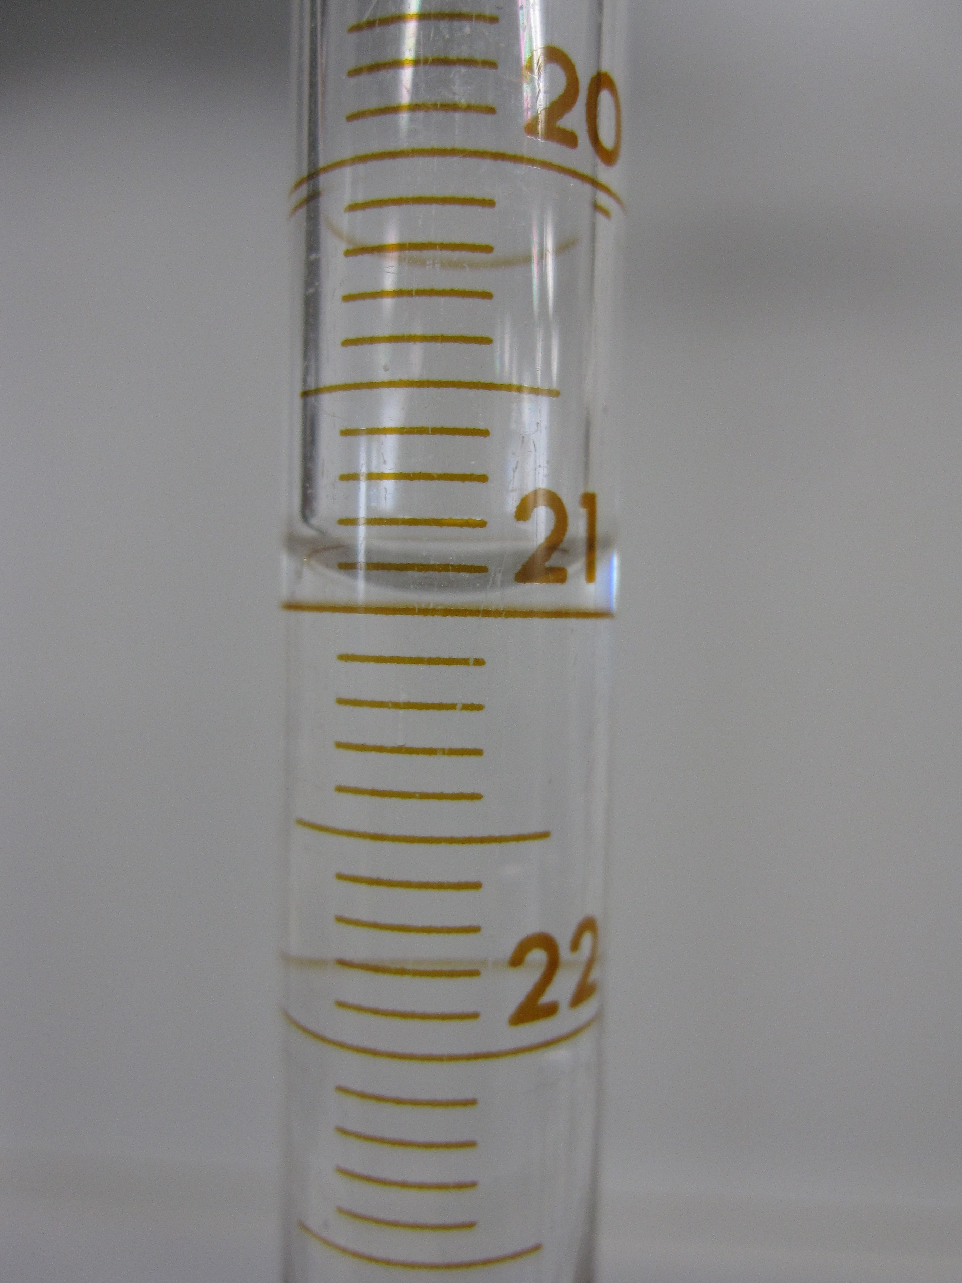
What volume is shown on this measuring cylinder?
Notes:
This has been deliberately chosen as a difficult measurement, where the meniscus is unclear.
In this case, the meniscus is between 21 and 21.1 cm³. The centre of the meniscus should be used, but this does not provide a clear answer here. This can be an interesting task for students. Could they say the volume is 21.05 cm3? What does that imply about the resolution of the instrument?
Suggested guidance:
Talk tasks can be used in a variety of ways to suit the particular needs of the students you are teaching. Through exchanging views with others, students develop their understanding of the science beyond what could be achieved individually.
Science classrooms that successfully integrate talk have the following features:
Science talk is a regular feature of lessons and is woven into classroom activities.
Students are paired or grouped strategically by the teacher to ensure productive interaction. This might take into consideration the students’ proficiency of the English language, how encouraging they might be to peers and their attainment in the topic. It’s a good idea to consider these pairings in the class seating plan.
Students are encouraged and supported to talk, but are not forced to talk.
The teacher should take on the role of a facilitator, engaging with conversations where necessary and encouraging or steering the conversation where needed.
Students are encouraged to use the language they have to express their ideas (e.g., everyday language, imperfect English, native language), but also to incorporate science specific terminology where this is more accurate or has been taught.
6. Scientifically inaccurate ideas are not dismissed by the partner or teacher; open discussion and further investigation are relied on to help students construct ideas that support them to progress in their scientific understanding.
7. Guidelines for behaviour during talk tasks are explicit and frequently reviewed. Rules for students might be:
Listen carefully to your partner
Take turns talking.
Speak one at a time, without interrupting.
Politely agree or disagree and explain why.
Politely point out if your partner has used a scientific word incorrectly, if they have explained the science incorrectly, or if there is a more accurate way to describe something.
If confused, ask questions.
Stay focused on the discussion topic.
Respond to one another.
Image source:
https://commons.wikimedia.org/wiki/File:Meniscus_of_water_in_burette.JPG

Slide 16
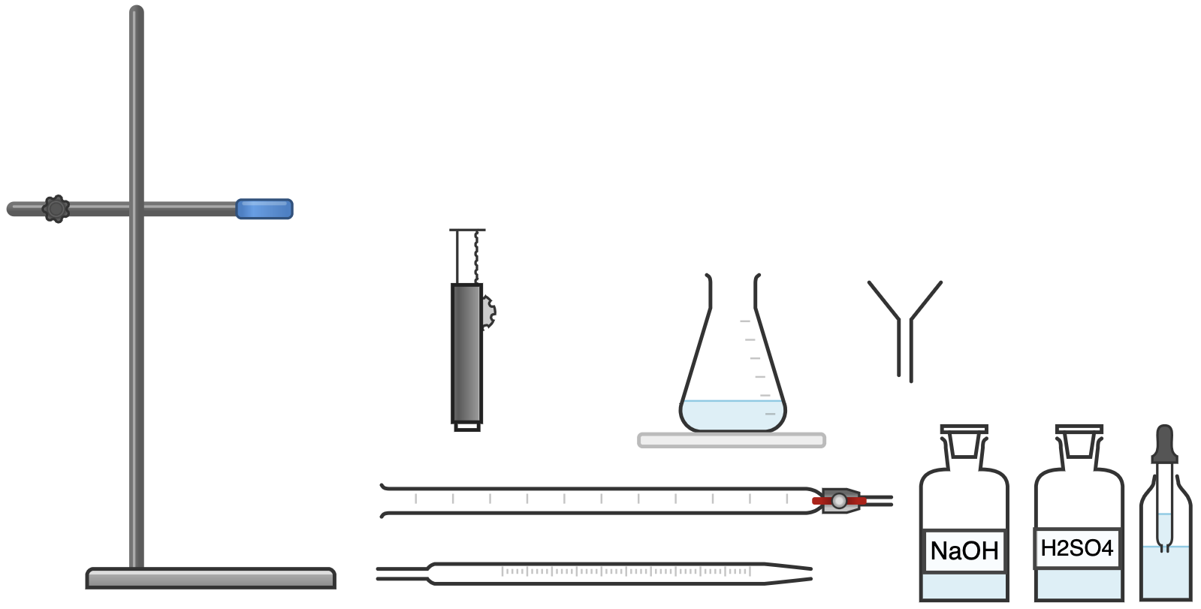
Using a burette
A burette is used to measure a variable volume, as the tap can be used to add liquid drop by drop.
Why should the tap be flushed after liquid is added to the burette?
How would the volume of liquid added be measured using a burette?
Why is the first titre often a rough result?
Notes:
These are key questions about experimental procedure, that should be reinforced before students carry out the practical.
The tap should be flushed to remove any air bubbles, as air bubbles would be included in the measured volume, making it inaccurate.
A burette is often upside down in terms of measurements, which students can sometimes take a bit of practice with. The starting volume on the burette and the final volume (once the end point has been detected) on the burette should be written down and the difference between them calculated. The difference is the volume that has been added.
The first titre is often a rough result because the experimenter does not have any idea where the end-point will be, so sometimes too much acid/alkali is added too quickly. Once the experimenter has a rough idea of the volume of acid/alkali that needs to be added, it is much easier to add the acid/alkali drop by drop when you get close to this volume.
Suggested guidance:
Talk tasks can be used in a variety of ways to suit the particular needs of the students you are teaching. Through exchanging views with others, students develop their understanding of the science beyond what could be achieved individually.
Science classrooms that successfully integrate talk have the following features:
Science talk is a regular feature of lessons and is woven into classroom activities.
Students are paired or grouped strategically by the teacher to ensure productive interaction. This might take into consideration the students’ proficiency of the English language, how encouraging they might be to peers and their attainment in the topic. It’s a good idea to consider these pairings in the class seating plan.
Students are encouraged and supported to talk, but are not forced to talk.
The teacher should take on the role of a facilitator, engaging with conversations where necessary and encouraging or steering the conversation where needed.
Students are encouraged to use the language they have to express their ideas (e.g., everyday language, imperfect English, native language), but also to incorporate science specific terminology where this is more accurate or has been taught.
6. Scientifically inaccurate ideas are not dismissed by the partner or teacher; open discussion and further investigation are relied on to help students construct ideas that support them to progress in their scientific understanding.
7. Guidelines for behaviour during talk tasks are explicit and frequently reviewed. Rules for students might be:
Listen carefully to your partner
Take turns talking.
Speak one at a time, without interrupting.
Politely agree or disagree and explain why.
Politely point out if your partner has used a scientific word incorrectly, if they have explained the science incorrectly, or if there is a more accurate way to describe something.
If confused, ask questions.
Stay focused on the discussion topic.
Respond to one another.

Slide 17
What steps do we take to make our measurements as accurate as possible?
The following steps are all things that should be done during a titration.
Explain how each helps to make the measurements as accurate as possible:
Rinsing the burette
Adding acid from the burette gradually/drop by drop
Swirling the conical flask while adding acid
Using a white tile
Reading volume of liquid from the centre of the meniscus at eye level
How will we know if our results are repeatable?
How will we know if our results are reproducible?
Notes:
Suggested points:
Rinsing the burette: to make sure there is no other solution in the burette that would affect the concentration of the acid
Adding acid from the burette gradually/drop by drop: so that the exact volume of acid needed is recorded to the nearest drop
Swirling the conical flask while adding acid: so that acid does not settle in one area of the solution. This can happen then when it is swirled, there is already enough acid to react with all the alkali
Using a white tile: to increase the contrast to notice the colour change against (rather than a desk/different colour)
Reading volume of liquid from the centre of the meniscus at eye level: so that the true volume is measured, reducing errors
Suggested guidance:
Talk tasks can be used in a variety of ways to suit the particular needs of the students you are teaching. Through exchanging views with others, students develop their understanding of the science beyond what could be achieved individually.
Science classrooms that successfully integrate talk have the following features:
Science talk is a regular feature of lessons and is woven into classroom activities.
Students are paired or grouped strategically by the teacher to ensure productive interaction. This might take into consideration the students’ proficiency of the English language, how encouraging they might be to peers and their attainment in the topic. It’s a good idea to consider these pairings in the class seating plan.
Students are encouraged and supported to talk, but are not forced to talk.
The teacher should take on the role of a facilitator, engaging with conversations where necessary and encouraging or steering the conversation where needed.
Students are encouraged to use the language they have to express their ideas (e.g., everyday language, imperfect English, native language), but also to incorporate science specific terminology where this is more accurate or has been taught.
6. Scientifically inaccurate ideas are not dismissed by the partner or teacher; open discussion and further investigation are relied on to help students construct ideas that support them to progress in their scientific understanding.
7. Guidelines for behaviour during talk tasks are explicit and frequently reviewed. Rules for students might be:
Listen carefully to your partner
Take turns talking.
Speak one at a time, without interrupting.
Politely agree or disagree and explain why.
Politely point out if your partner has used a scientific word incorrectly, if they have explained the science incorrectly, or if there is a more accurate way to describe something.
If confused, ask questions.
Stay focused on the discussion topic.
Respond to one another.

Slide 18
Drill
Give the name for the volume of liquid that is measured using a titration.
Define concordant results.
Describe the function of the indicator in a titration.
Describe the function of the white tile in a titration.
Define the end-point of a titration.
Name the piece of equipment that should be used to measure a fixed volume.
Name the piece of equipment that should be used to measure a variable volume.
Notes:
Purpose: This is a knowledge drill. The purpose of this is to check that the critical knowledge is secure before pupils move onto independent practice.
Suggested guidance: There are a range of ways this could be done depending on time and ability range of the class:
Mini whiteboards
As full sentences in exercise books
As short answers in exercise books
In the pupil workbook
As pair talk
As cold call

Slide 19
Drill answers
Titre
Results that fall within 0.2 cm³ of each other.
To signify the end-point (where the acid/alkali has been completely neutralised).
It is placed underneath the conical flask so that the colour change can be seen more clearly.
When the acid or alkali has been completely neutralised.
Pipette
Burette
Notes:
Purpose: This is a knowledge drill. The purpose of this is to check that the critical knowledge is secure before pupils move onto independent practice.
Suggested guidance: There are a range of ways this could be done depending on time and ability range of the class:
Mini whiteboards
As full sentences in exercise books
As short answers in exercise books
In the pupil workbook
As pair talk
As cold call

Slide 20
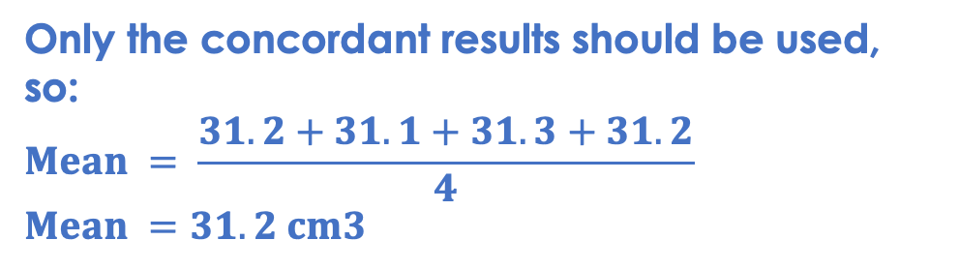
I: identifying concordant results
Titration | Volume of acid used (cm³)
1 | 34.5
2 | 31.2
3 | 31.1
4 | 31.3
5 | 31.2
A student uses a titration to determine the volume of sulfuric acid needed to neutralise 25 cm³ of sodium hydroxide solution.
Their results are shown in the table.
Which values from the table are concordant measurements?
Measurements from titrations 2-5, as they are within 0.2 cm³ of each other.
Which might the measurement from titration 1 be different from the others?
The first titre is often a rough measurement, after which the investigator has a better idea of when to expect the end-point. This means they will know when to start adding acid drop by drop.
What is the mean volume of acid used?
Only the concordant results should be used, so:
$$Mean = \frac{31.2+31.1+31.3+31.2}{4}$$
$$Mean =31.2 cm3$$
Notes:
Purpose: The I-We-You section aims to support pupils to build skills that they most commonly need when answering questions associated with this knowledge in the assessment. This section is also used to interleave other content we expect pupils to know at this stage of their education in order that they build a big picture of the science they are learning.
For the ‘I’ activity, the teacher should model how to answer the question. They can do this by narrating their thinking process aloud, and making links to learning earlier in the lesson explicit.
For the ‘we’ activity, the teacher and students work though a similar example together, in order to prepare students to be able to answer a similar question independently.
Opportunities for the ‘you’ activity – independent practise – occur in the activity portion of the lesson once the student is secure enough to process independently.

Slide 21
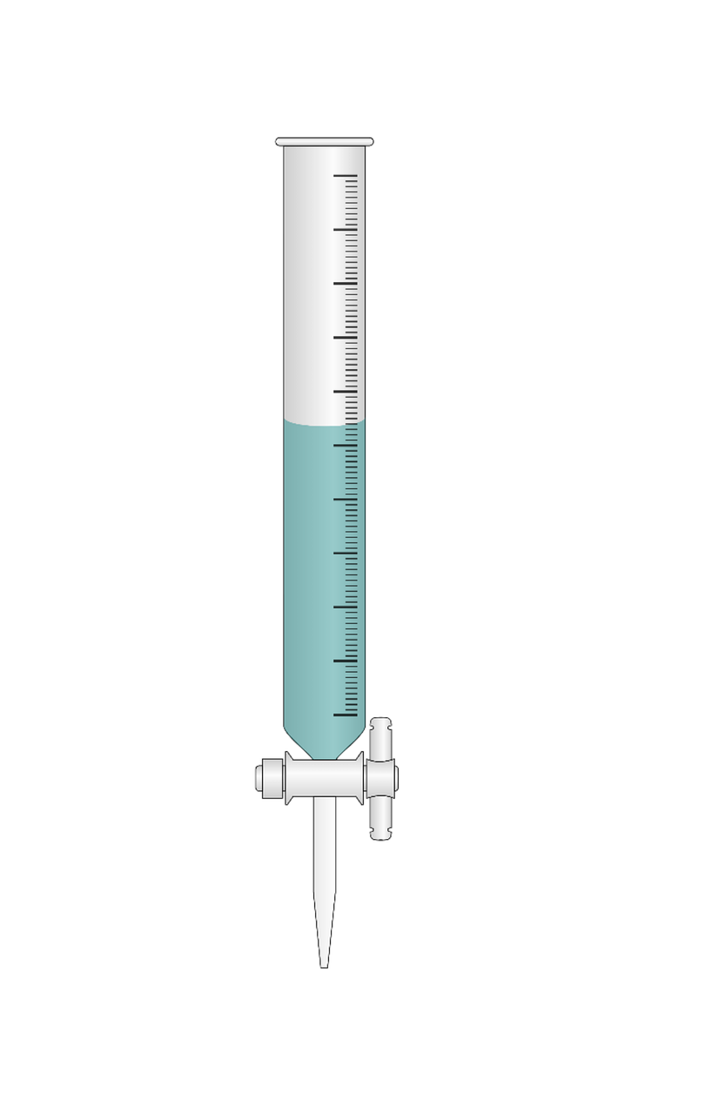
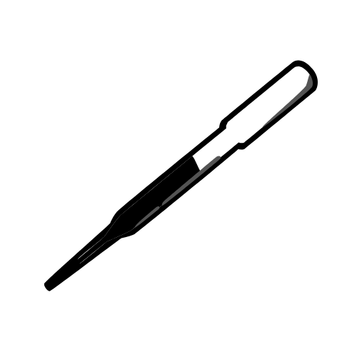
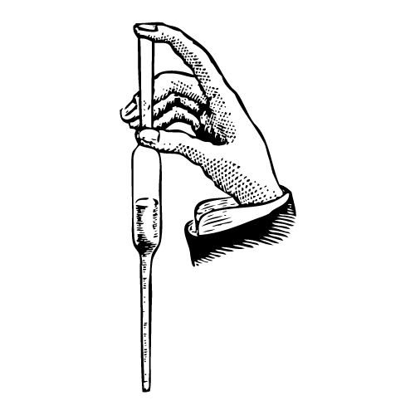

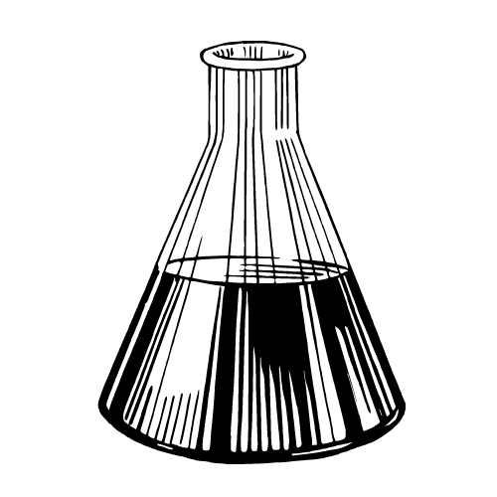
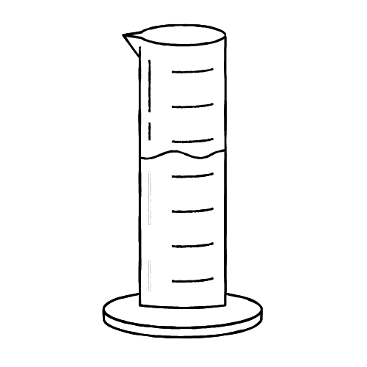
We: measuring volume and uncertainty
Different instruments can be used to measure volumes of liquids.
What instruments could be used to measure the volume of a liquid?
Beaker, measuring/graduated cylinder, pipette, conical flask, burette
What instruments would allow the most precise measurements to be taken? Why?
A pipette. It has the highest resolution.
A measuring cylinder has a resolution of 1 cm³. Calculate the uncertainty when using this to measure a liquid.
Uncertainty = half the resolution. Uncertainty = 0.5 cm³
A pipette has a resolution of 0.1 cm³. Calculate the uncertainty when using this to measure a liquid.
Uncertainty = half the resolution. Uncertainty = 0.05 cm³
Notes:
Purpose: The I-We-You section aims to support pupils to build skills that they most commonly need when answering questions associated with this knowledge in the assessment. This section is also used to interleave other content we expect pupils to know at this stage of their education in order that they build a big picture of the science they are learning.
For the ‘I’ activity, the teacher should model how to answer the question. They can do this by narrating their thinking process aloud, and making links to learning earlier in the lesson explicit.
For the ‘we’ activity, the teacher and students work though a similar example together, in order to prepare students to be able to answer a similar question independently.
Opportunities for the ‘you’ activity – independent practise – occur in the activity portion of the lesson once the student is secure enough to process independently.

Slide 22
You: explaining the purpose of equipment
A student uses a titration to determine the concentration of calcium hydroxide.
They use 40 cm³ of 0.75 mol/dm³ nitric acid solution.
What piece of equipment should be used to measure the volume of nitric acid? Why?
A pipette. It can accurately measure a fixed volume.
What piece of equipment should be used to measure the volume of calcium hydroxide that is added. Why?
A burette. It can measure a variable volume drop by drop.
Why is a white tile placed underneath the conical flask?
So that the colour change is easier to see.
Why should an indicator such as phenolphthalein or methyl orange be used instead of Universal Indicator?
These indicators show an obvious colour change. Universal Indicator would not show a clear end point.
Notes:
Purpose: The I-We-You section aims to support pupils to build skills that they most commonly need when answering questions associated with this knowledge in the assessment. This section is also used to interleave other content we expect pupils to know at this stage of their education in order that they build a big picture of the science they are learning.
For the ‘I’ activity, the teacher should model how to answer the question. They can do this by narrating their thinking process aloud, and making links to learning earlier in the lesson explicit.
For the ‘we’ activity, the teacher and students work though a similar example together, in order to prepare students to be able to answer a similar question independently.
Opportunities for the ‘you’ activity – independent practise – occur in the activity portion of the lesson once the student is secure enough to process independently.

Slide 23
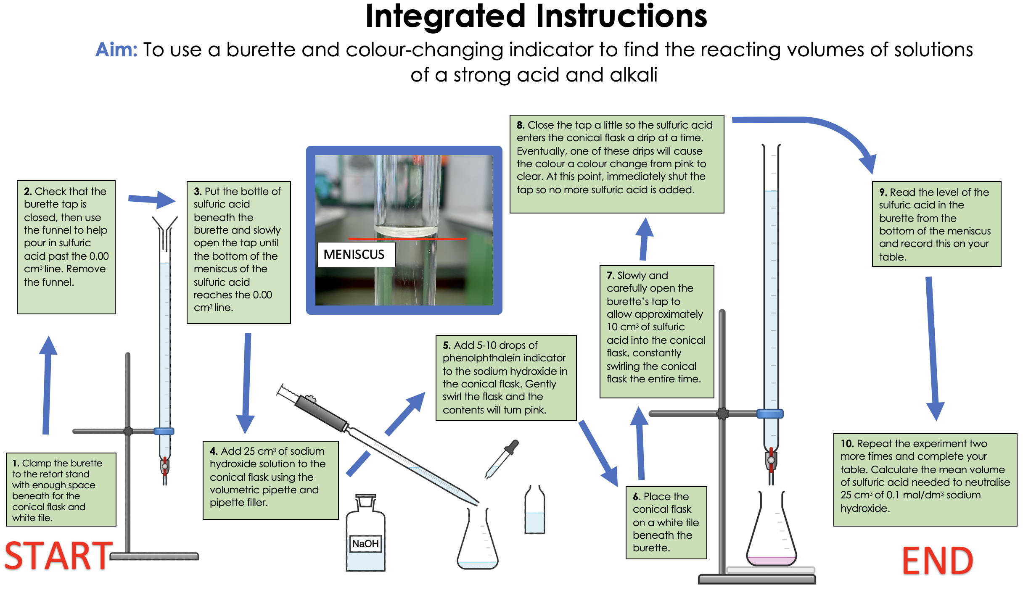
Complete the required practical activity using the student sheet and the integrated instructions

Slide 24
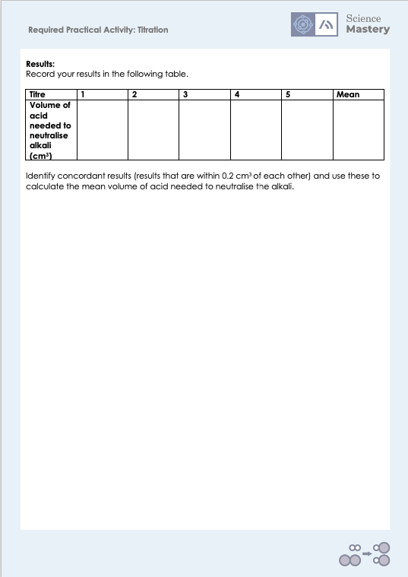
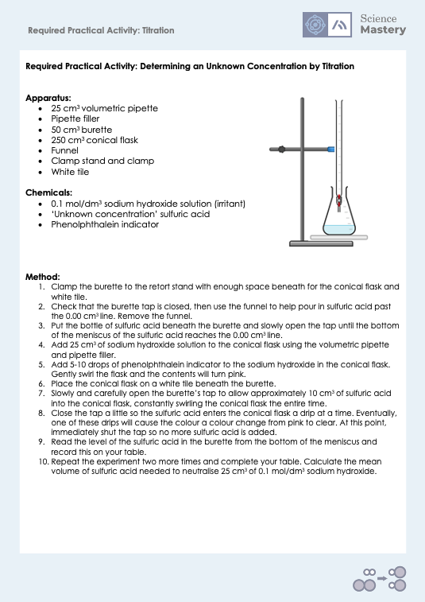
Required Practical Activity
Keep your results until the next lesson, where they will be used to calculate the concentration of acid.
Notes:
Note: students to note results in this lesson, identify concordant results and calculate a mean.
They will only use their results to calculate a concentration in the next lesson.

Slide 25
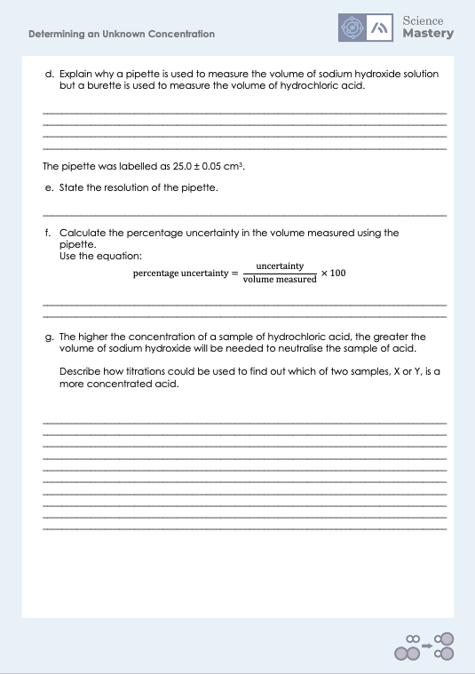
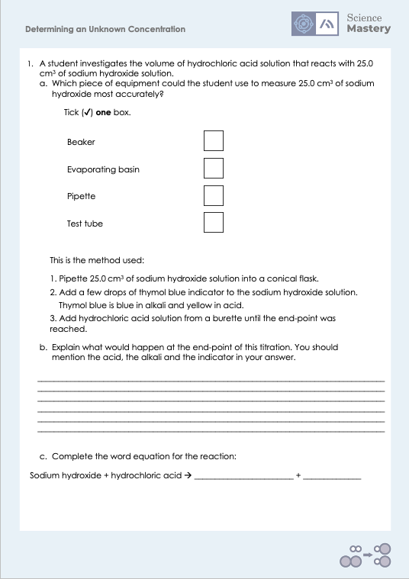
Activity

Slide 26
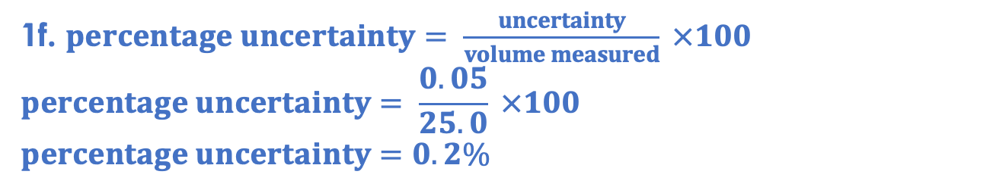
Answers
1a. Pipette
1b.
The indicator (thymol blue) will change colour
from blue to yellow
when the acid has completely neutralised the alkali
1c.
Sodium hydroxide + hydrochloric acid → sodium chloride + water
1d. A pipette measures a fixed volume accurately, but a burette can measure a variable/investigated volume drop by drop.
1e. 0.1 cm³
1f. $percentage uncertainty= \frac{uncertainty}{volume measured} ×100$
$$percentage uncertainty= \frac{0.05}{25.0} ×100$$
$$percentage uncertainty=0.2\%$$

Slide 27
Answers
1g. Suggested points:
measure the volume of acid (using a pipette)
place into a conical flask (on top of a white tile)
add indicator to the acid (and swirl)
add sodium hydroxide solution
until the colour changes
record the volume of sodium hydroxide solution added
repeat procedure with the other acid
compare the two volumes of sodium hydroxide solution to find which sample X or Y is more concentrated

Slide 28
Answer the questions below.
What is the end point of a titration?
A. When the acid/alkali has been completely neutralised
B. When all of the acid/alkali has been used up
C. The volume used to complete the titration
✓
Which explains why an indicator such as phenolphthalein is used for titration rather than Universal Indicator?
A. It has an obvious colour change
B. It speeds up the reaction
C. It is cheaper and easier to obtain
✓
Which is the most appropriate piece of apparatus to measure a volume of 25 cm³?
A. A measuring cylinder
B. A conical flask
C. A pipette
✓
Notes:
Q1. Answer: A
If students answer B, this is a common misconception that ’all the acid or alkali has been used up’, which is a confusion about the volume of one reactant running out. If students answer C, they have confused the end point with the titre. To fix it, review the meaning of the end point of a titration.
Q2. Answer: A
If students answer B or C, they have not recognised the function of the indicator. Answering C shows that students have chosen a generic ‘advantage’. To fix it, you may wish to demo quickly a titration using universal indicator, showing how subjective the end point would be and explain why phenolphthalein would be used rather than Universal indicator.
Q3. Answer: C
If students answer A or B, they have not linked the precision of measurements to the resolution of equipment. To fix it, review the meaning of precise measurements and model for students how different measurements would result from using less precise instruments.

Slide 29
Lesson C4.3.11 C4.3.12
What was good about this lesson? | What can we do to improve this lesson?
Send us your feedback by clicking this link
or by emailing sciencemastery@arkonline.org
Thank you!

